Slide 1

HOA
The chatbot made to help you with Mental Health Issues
Sarah Busson
Ironhack Amsterdam
Data Analytics – Cohort 07/20

Slide 2
Table of contents
Mental Health
Mental Health & AI
Who is HOA ?
How does it work ?
Performance
Demo
Improvements

Slide 3

Mental Health
Psychological well-being
Affect how we feel, think and act
Change mood and behaviour
Brain factors and/or life experiences
1 out of 8 people is facing mental disorder
1 suicide every 40 seconds
Disorders remain poorly understood by ourselves

Slide 4
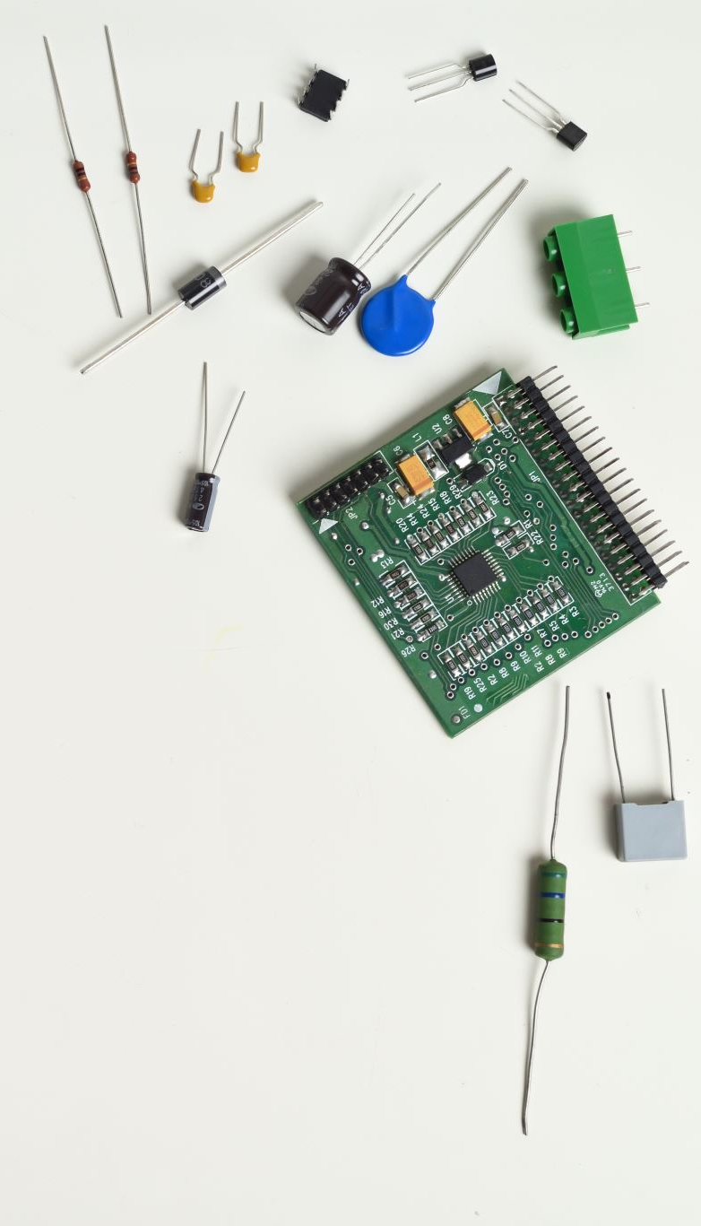
Mental Health & AI
Diagnosis
Natural Language Processing
Facial recognition
Help make sure patients stay active in their self-care
Chatbots
Deliver first hand solution
Redirect to the right specialist
Initial support if not ready to open up

Slide 5
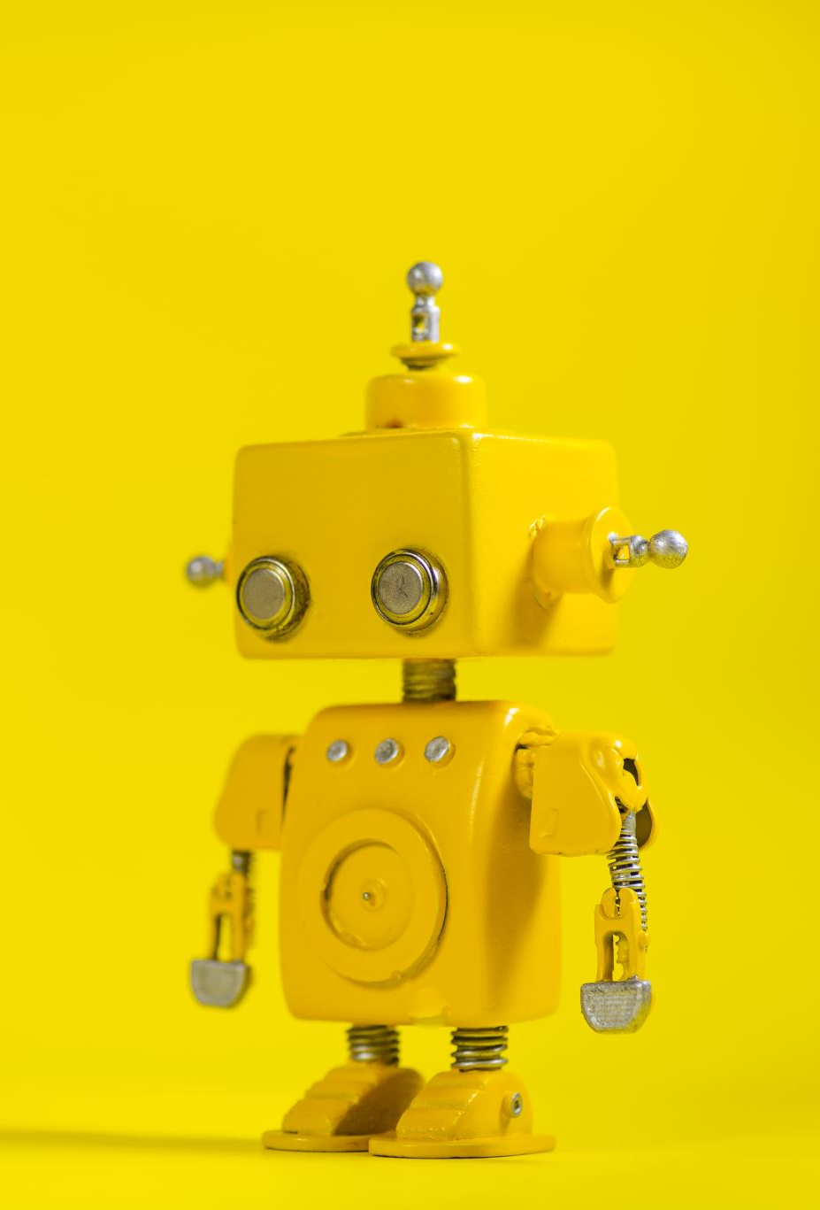
Who is HOA ?
HOA doesn’t replace a therapist
Maintain a conversation to recognize a pattern
Gives back an appropriate solution
Combination of technologies
Conversational Chatbot
NLP
Deep Learning Neural Network
API + DB connection

Slide 6
How does it work ?
Trained on dialogue corpus
Return best match
Continuous learning – save conversation in SQL DB
CHATBOT
Sequential Tensorflow model
Vectorized corpus from online client-therapist forum
Return 1 – 3 most likely topics
DL NN TOPIC
Output based
Return answer from medical website via API connection
API - DB

Slide 7
How does it work ?
Trained on dialogue corpus
Return best match
Continuous learning – save conversation in SQL DB
Sequential Tensorflow model
Vectorized corpus from online client-therapist forum
Return 1 – 3 most likely topics
DL NN TOPIC
Output based
Return answer from medical website via API connection
API - DB

Slide 8
How does it work ?
Trained on dialogue corpus
Return best match
Continuous learning – save conversation in SQL DB
Sequential Tensorflow model
Vectorized corpus from online client-therapist forum
Return 1 – 3 most likely topics
Output based
Return answer from medical website via API connection
API - DB

Slide 9
How does it work ?
Trained on dialogue corpus
Return best match
Continuous learning – save conversation in SQL DB
Sequential Tensorflow model
Vectorized corpus from online client-therapist forum
Return 1 – 3 most likely topics
Linked to NN output
Return answer from medical website via API connection

Slide 10

Performance
Chatbot and NLP :
3 600 conversations
Dialogue Corpus
Vectorize on 1 000 most common words from corpus
Tokenization
Lemmatization
Vectorization
Cleaning

Slide 11
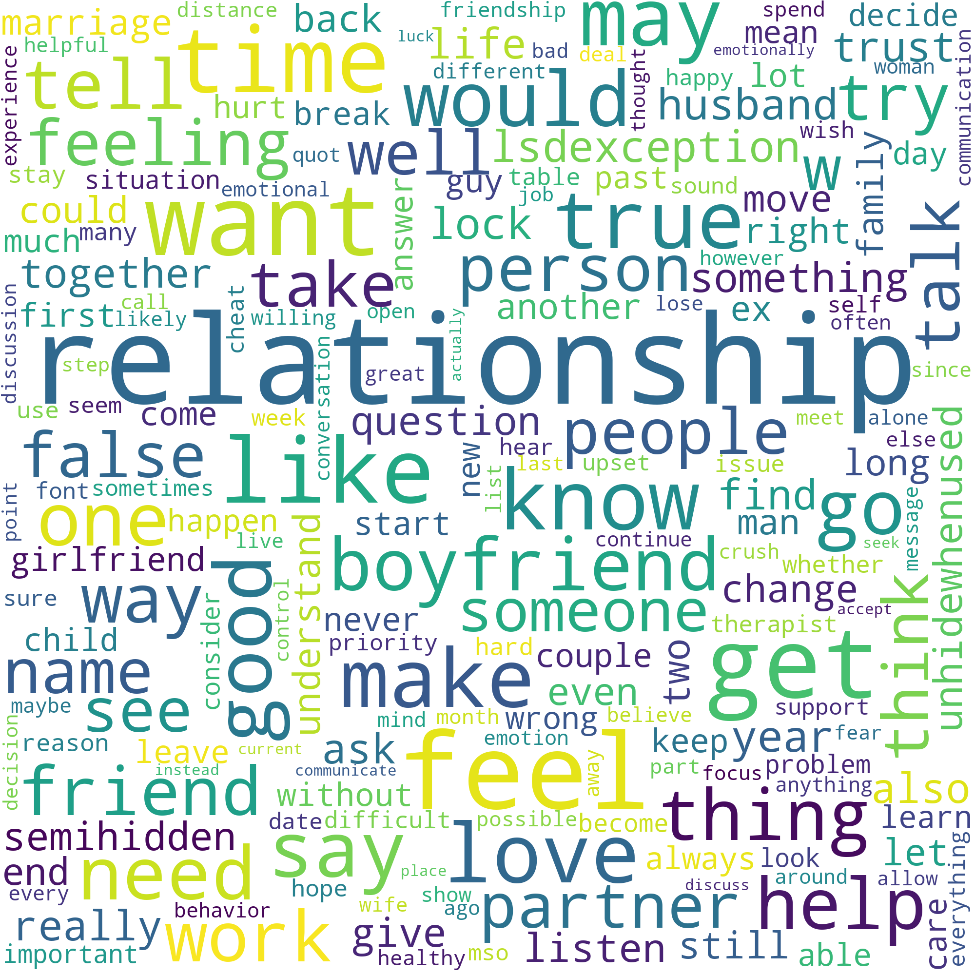
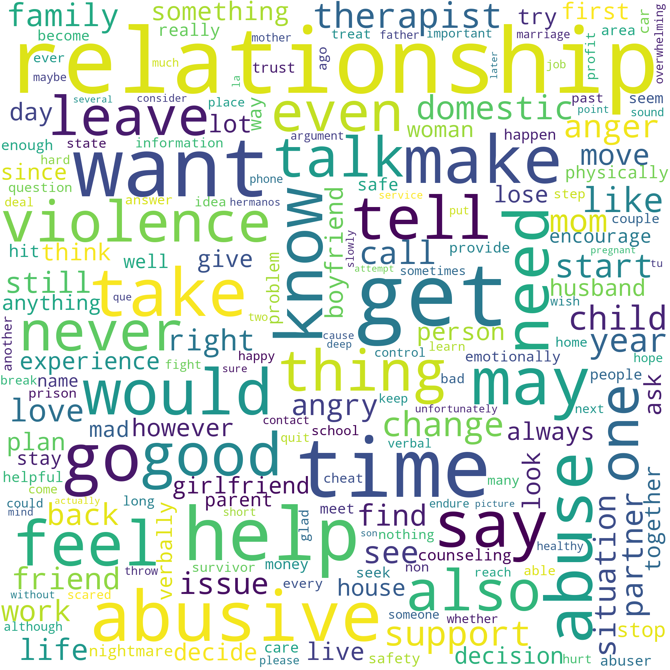
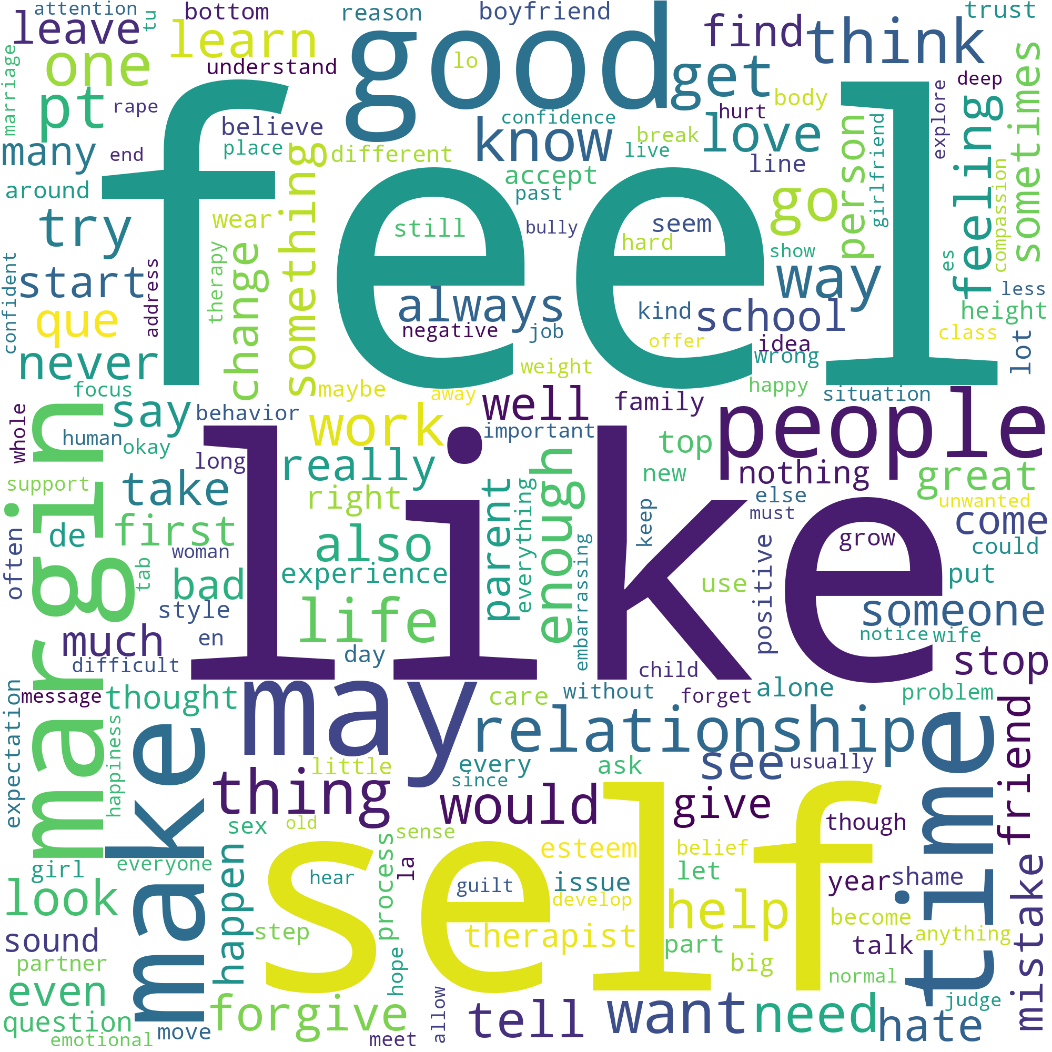
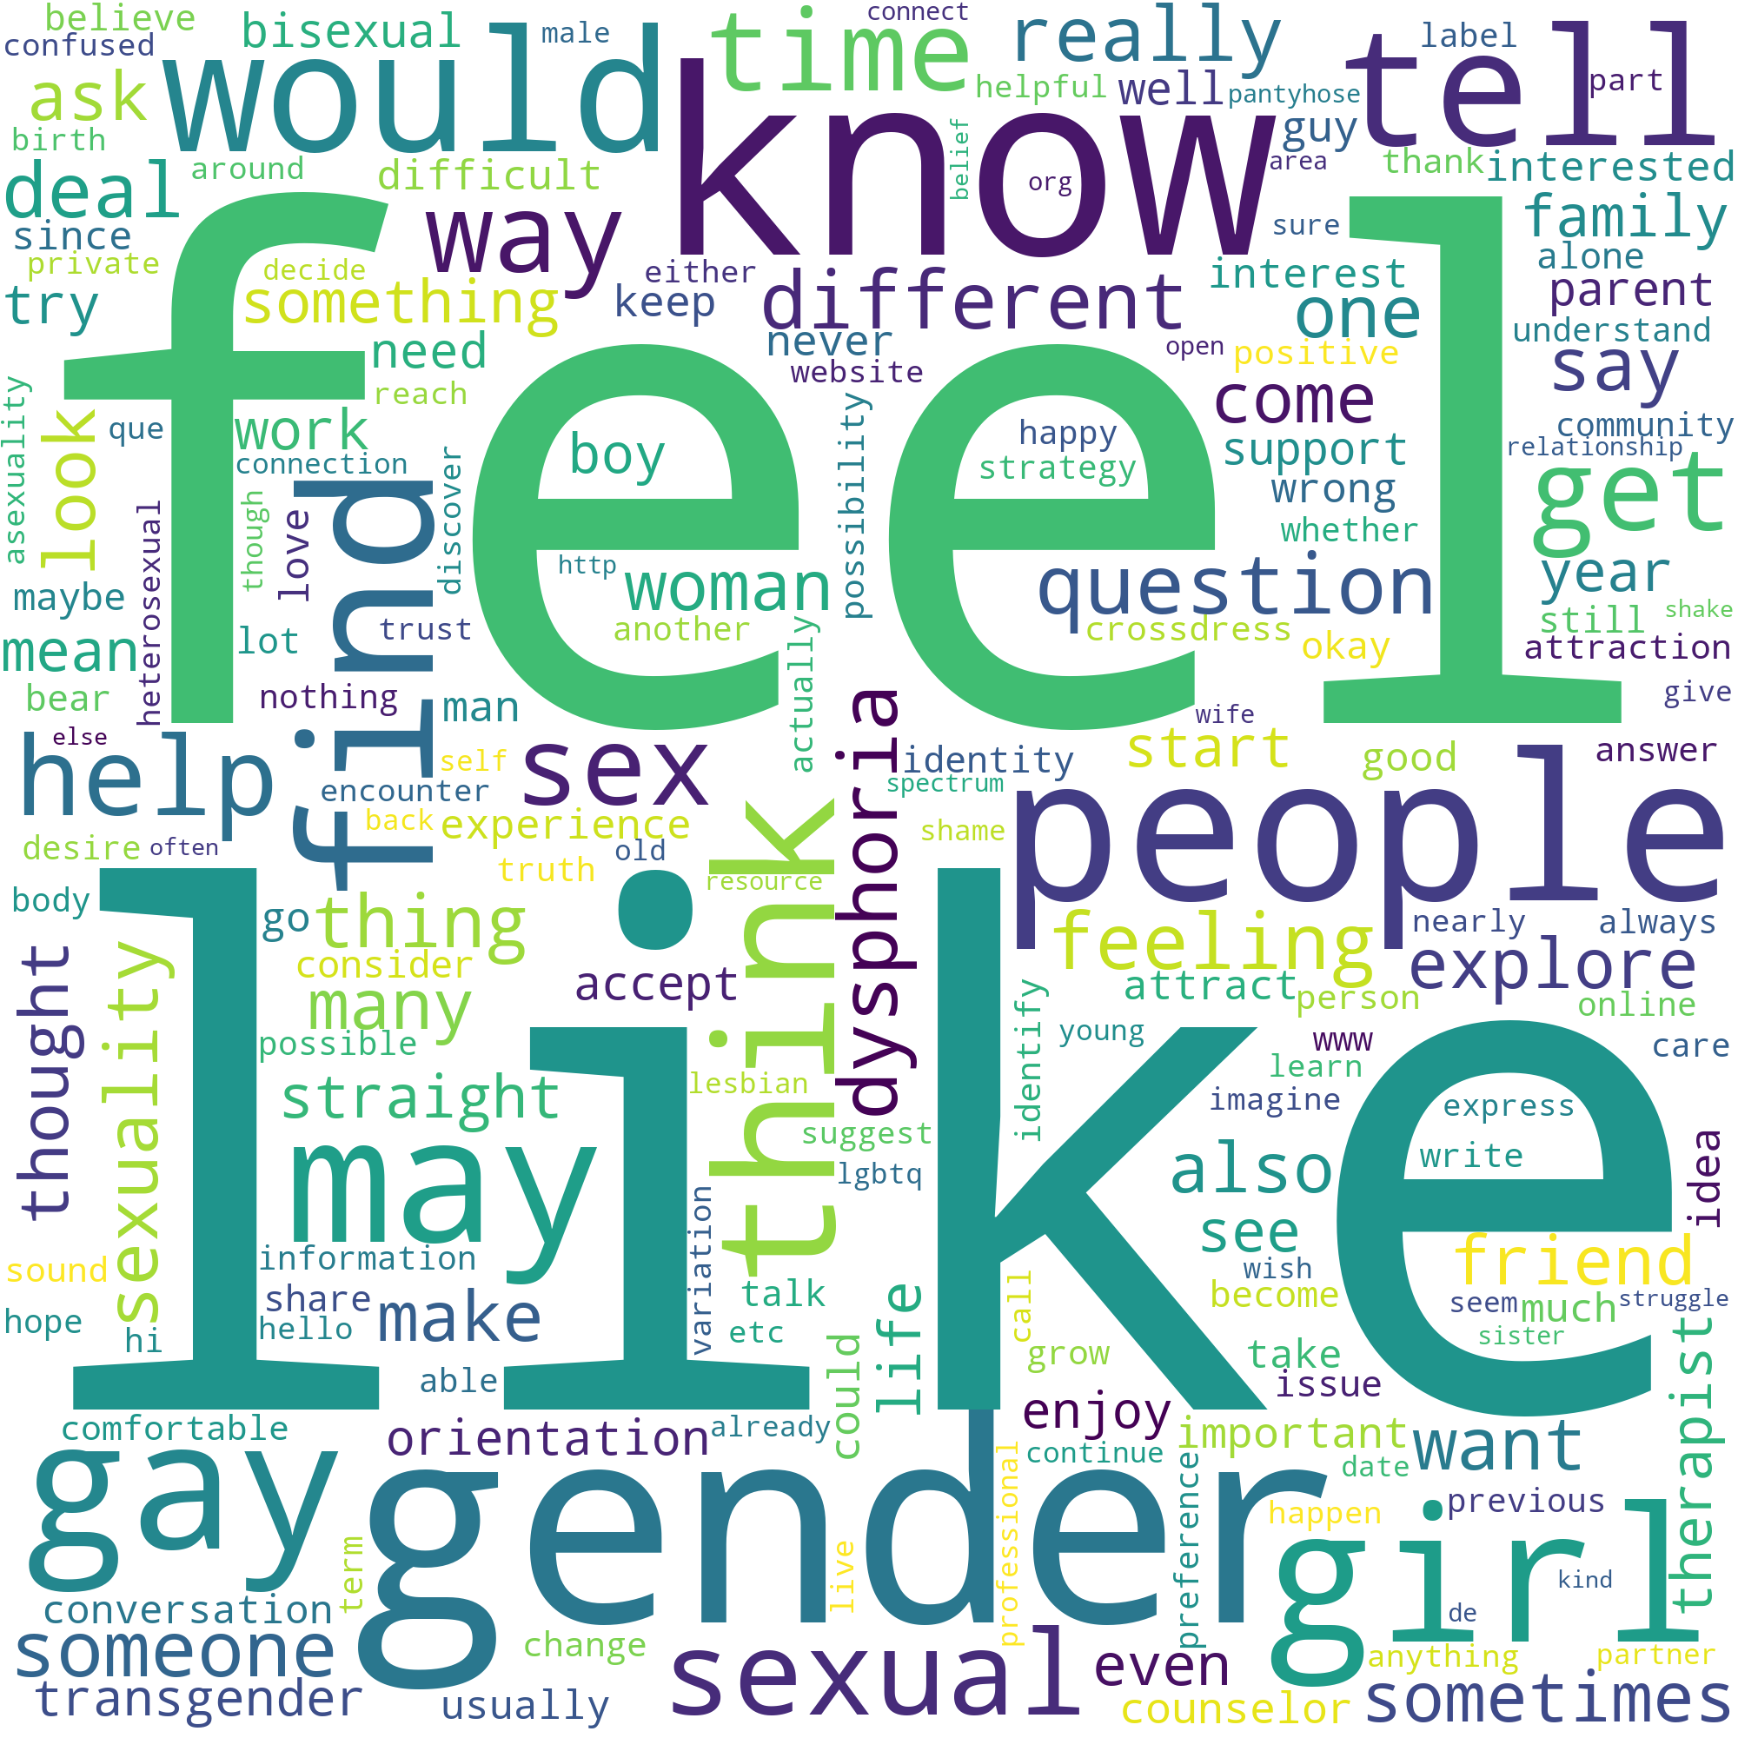
Performance
RELATIONSHIPS
DOMESTIC VIOLENCE
Parameters:
3 600 conversations
18 outputs
85-15% split
Training set :
Accuracy : 96%
Loss : 0.07
Test set :
Accuracy : 77%
Loss : 0.95
SELF-ESTEEM
LGBTQ

Slide 12
Performance
DOMESTIC VIOLENCE
Parameters:
3 600 conversations
18 outputs
85-15% split
Training set :
Accuracy : 96%
Loss : 0.07
Test set :
Accuracy : 77%
Loss : 0.95
RELATIONSHIPS
SELF-ESTEEM
LGBTQ

Slide 13
Performance
Parameters:
3 600 conversations
18 outputs
85-15% split
Training set :
Accuracy : 96%
Loss : 0.07
Test set :
Accuracy : 77%
Loss : 0.95
RELATIONSHIPS
DOMESTIC VIOLENCE
SELF-ESTEEM
LGBTQ

Slide 14
Performance
Parameters:
3 600 conversations
18 outputs
85-15% split
Training set :
Accuracy : 96%
Loss : 0.07
Test set :
Accuracy : 77%
Loss : 0.95
RELATIONSHIPS
DOMESTIC VIOLENCE
SELF-ESTEEM
LGBTQ

Slide 15
Performance
Parameters:
3 600 conversations
18 outputs
85-15% split
Training set :
Accuracy : 96%
Loss : 0.07
Test set :
Accuracy : 77%
Loss : 0.95
RELATIONSHIPS
DOMESTIC VIOLENCE
SELF-ESTEEM
LGBTQ

Slide 16
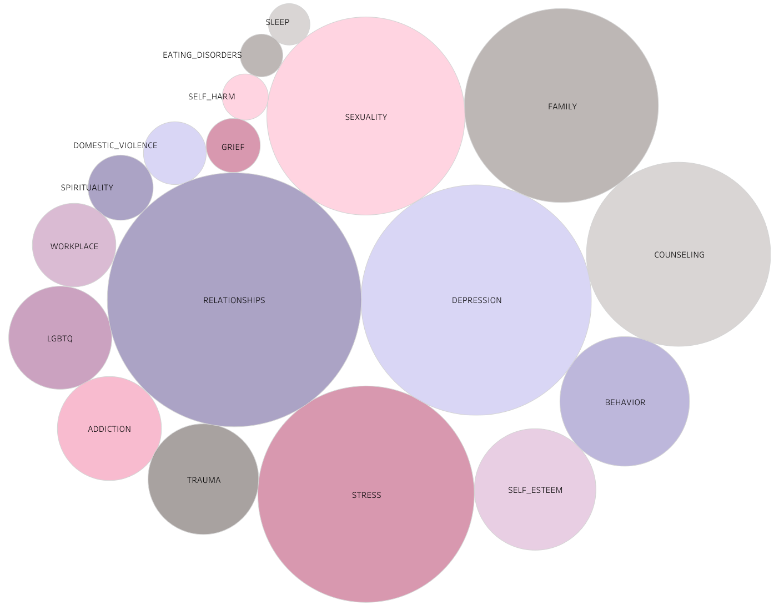

Slide 17
DEMO

Slide 18
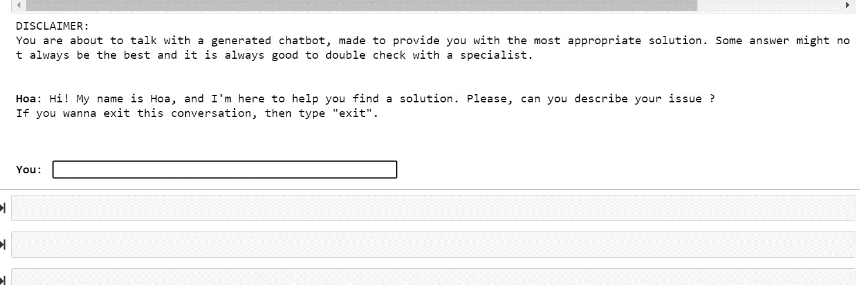

Slide 19
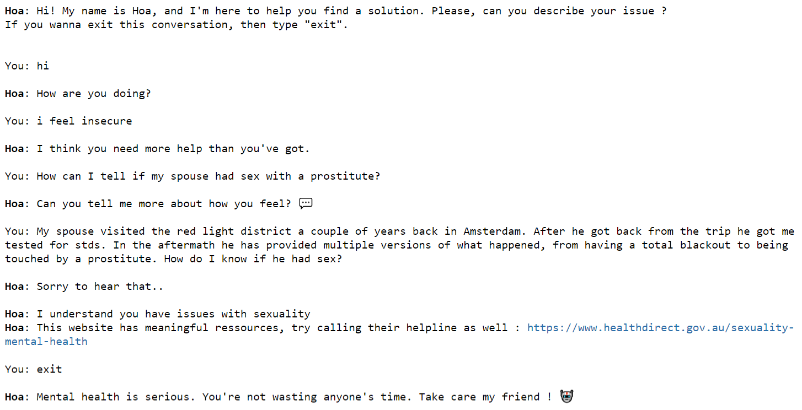

Slide 20

Improvements
Develop an interface or integration
Train HOA & the DL algorithm with more data
Use key words recognition
Topics + Subtopics
Better understanding of the subject
More solutions
More personal

Slide 21
Conclusion
HOA is not functional yet
For DL and Chatbot, dataset is too little
NN model doesn’t need many features to be good

Slide 22
Thank you !
Do you have any questions ?

